Slide 1


SENSOR FUSION WITH CAMERA,RADAR
MAGIC@KARE

Slide 2
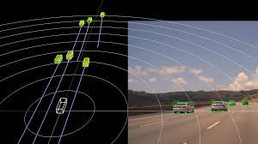
Radar based road user detection
A radar-based method for detecting moving road users which:
Multi-class(Pedestrians,cyclists and cars)
Provide classification both at the target and object level
Single-frame(does not need to accumulate sensor data over time)
The commercially available automotive radars output a 2D point-cloud of radar targets. Each target has a 2D position, a radial speed, and a Radar Cross Section value.
MAGIC@KARE

Slide 3
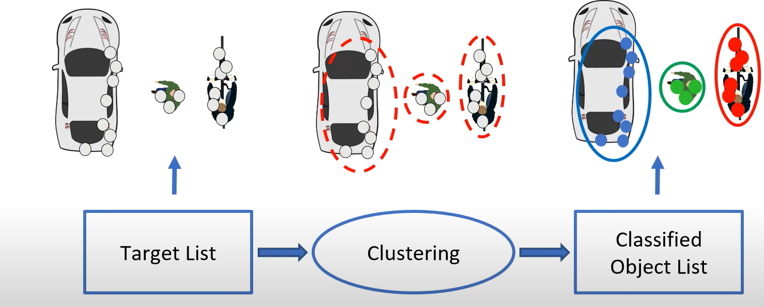
Conventional Pipeline
Features are extracted per cluster classification is done per cluster
MAGIC@KARE

Slide 4
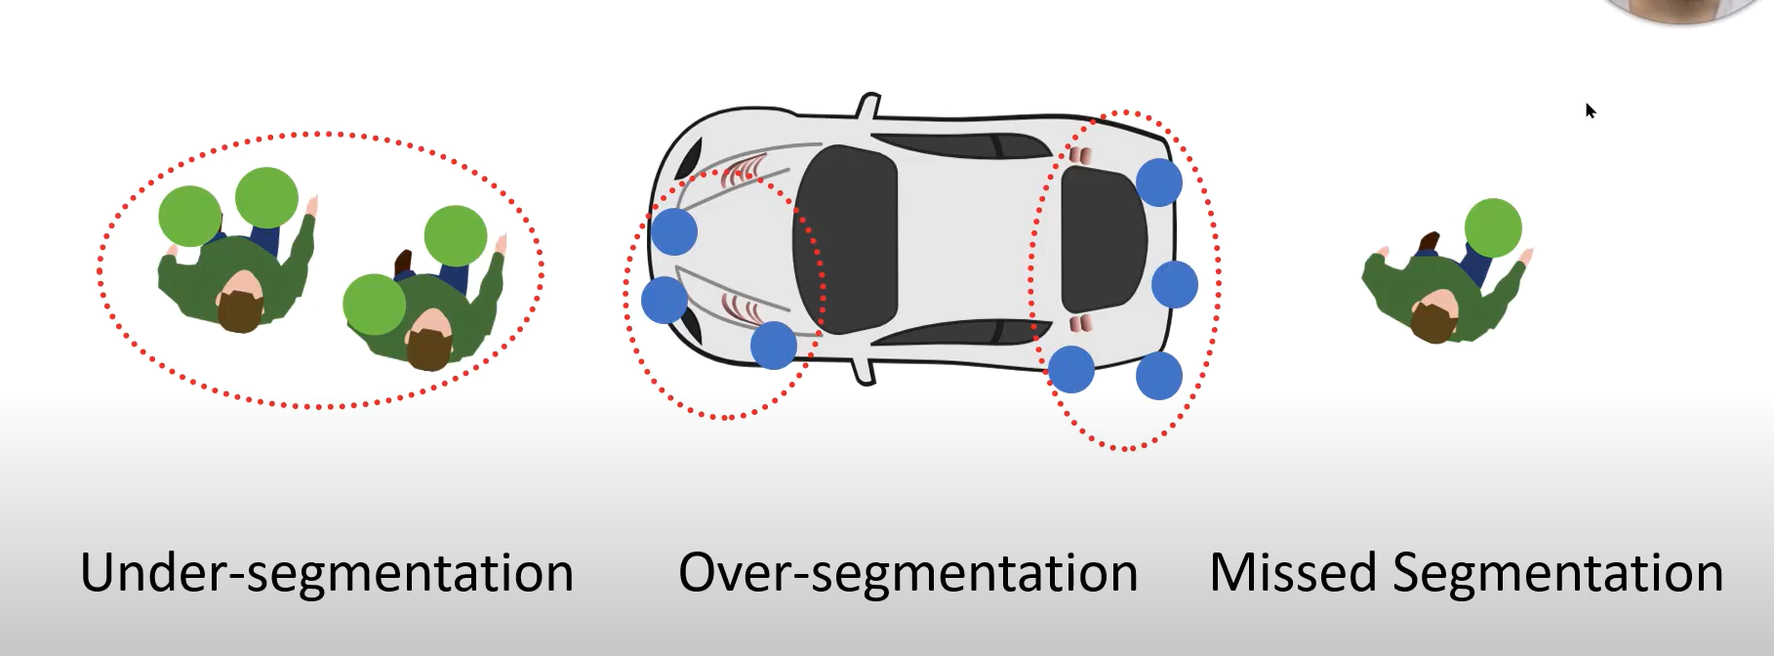
MAGIC@KARE

Slide 5
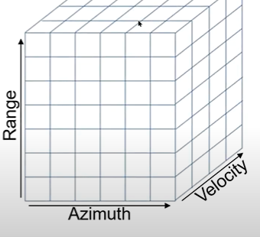
Radar Cube:
A lower level of radar data is called the radar cube.
It has three axes: range, azimuth, and velocity.
One cell represents reflectivity at:
That 2D position (range, azimuth index)
That speed(velocity index)
A column of the cube at a range-azimuth index contains the full velocity distribution at that 2D location
MAGIC@KARE

Slide 6
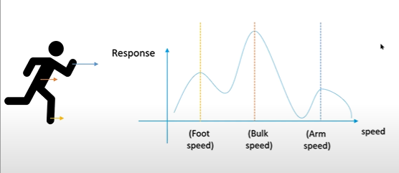
The speed distribution is class-characteristic, since it depends on what kind of moving parts does the object have.
A method that exploits this speed distribution for road user detection
MAGIC@KARE

Slide 7
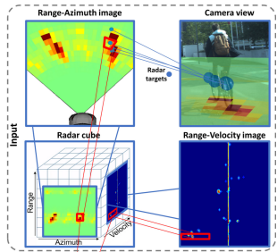
To exploit this low-level data, we:
Map the radar targets into the radar cube by their 2D location and velocity
2. Crop a 3D block around them
MAGIC@KARE

Slide 8
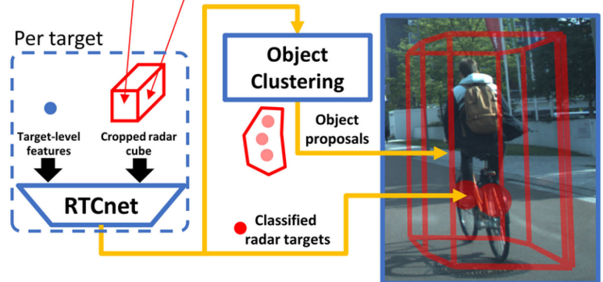
RTCnet:
RTCnet is a Convolutional Neural Network designed to classify each target individually into pedestrian ,cyclist ,car or other class
Afterwards, It will create object proposals in class-specific clustering
The advantage of class-specific clustering is that we can use different clustering parameters for each class
Eg: larger radius for cars
MAGIC@KARE

Slide 9
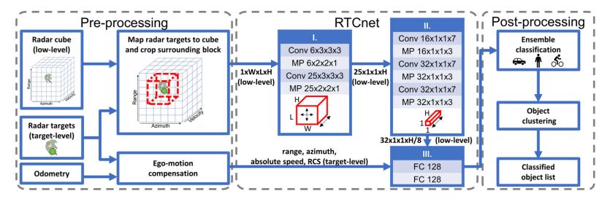
MAGIC@KARE

Slide 10
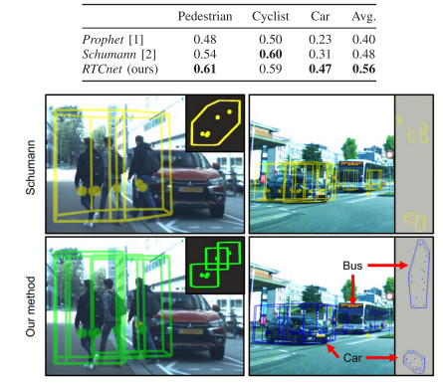
F1 SCORE OBJECT-WISE
MAGIC@KARE

Slide 11
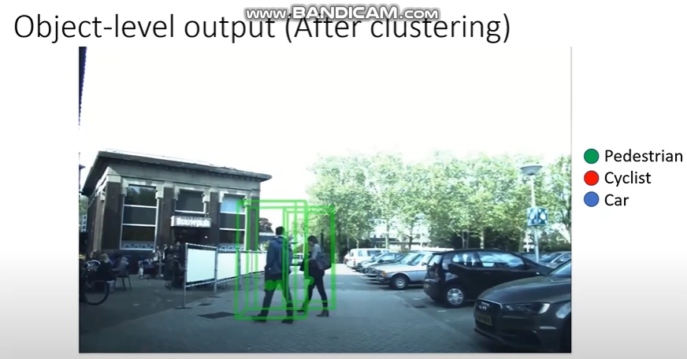
Output of RTCnet:
MAGIC@KARE

Slide 12
Conclusion:
A radar based, single-frame, multiclass road user detection method. It exploits class information in low-level radar data by applying a specially designed neural network to a cropped block of the radar cube around each radar target and the target-level features.
A clustering step was introduced to create object proposals.
the proposed method outperforms the baselines overall in object-wise classification by yielding an average F1 score of 0.56
Temporal integration and/or tracking of objects could further improve the method’s performance and usability.
Reference:
Palffy, Andras, et al. "CNN based road user detection using the 3D radar cube." IEEE Robotics and Automation Letters 5.2 (2020): 1263-1270.
MAGIC@KARE

Slide 14
INTRODUCTION:
Sensor Fusion:
Sensor fusion is the process of combining data from multiple sensors to provide a more comprehensive and accurate representation of the environment or system being monitored.
The ability to bring together inputs from multiple radars and cameras to form a single model or image of the environment around a vehicle.
The resulting model is more accurate because it balances the strengths of the different sensors.
Calibration:
It is the process where a sensor is adjusted, as accurately or error free as possible. With this , errors that occur through sensors are measured.
The goal of calibration is to make the measurement system produce results that are as close as possible to the true values of the quantities being measured.
MAGIC@KARE

Slide 15
SENSOR CALIBRATION:
With the significant advancement of sensor and communication technology and the reliable application of obstacle detection techniques and algorithms, automated driving is becoming a pivotal technology that can revolutionize the future of transportation and mobility
Sensors are fundamental to the perception of vehicle surroundings in an automated driving system, and the use and performance of multiple integrated sensors can directly determine the safety and feasibility of automated driving vehicles.
Sensor calibration is the foundation block of any autonomous system and its constituent sensors and must be performed correctly before sensor fusion and obstacle detection processes may be implemented.
MAGIC@KARE

Slide 16
OBJECTIVE:
The objective of calibration in sensor fusion is to improve the accuracy and reliability of the fused data obtained from multiple sensors.
The process of combining data from multiple sensors to provide a more comprehensive and accurate representation of the environment or system being monitored.
However, each individual sensor has its own limitations and errors, which can affect the accuracy of the fused data.
This research is to provide efficient in-depth coverage of Camera and Rader signal processing.
MAGIC@KARE

Slide 17
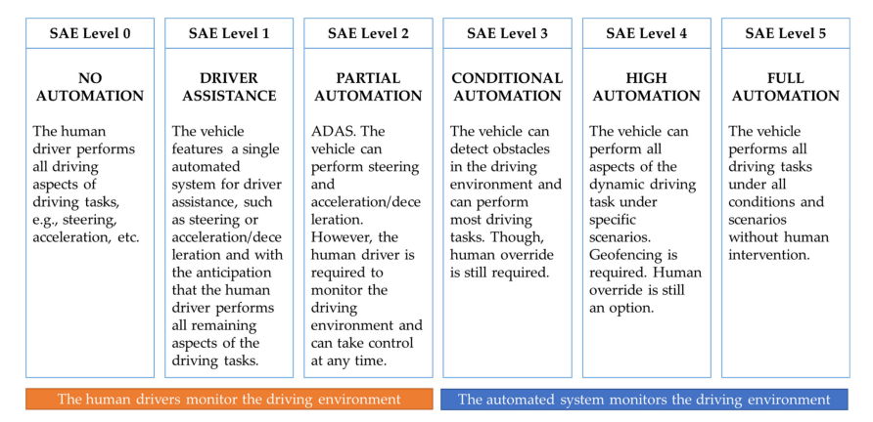
LITERATURE SURVEY:
An overview of the six distinct levels of driving automation that were described in the Society of Automotive Engineers (SAE)
MAGIC@KARE

Slide 18
Sl.no | Title of the paper | Summary
1. | A Review of Multi-Sensor Fusion System for Large Heavy Vehicles Off Road in Industrial Environments | A summary of advantages and disadvantages of perception-based sensors and the architecture of multi-sensor setup for obstacle detection in industrial environments. Moreover, the authors highlighted some of the challenges to temporal synchronize multiple data streams in AD applications
2. | A Review of Data Fusion Techniques | A discussion of the classification of data fusion techniques based on several criteria and providing a comprehensive overview of the most employed methods and algorithms for data association, state estimation, and decision fusion tasks
3. | A Systematic Review on Fusion Techniques and Approaches Used in Applications | A discussion of the current state-of-the-art multi-sensor fusion techniques and approaches for various applications such as obstacle detection, localization, and mapping, in three major domains, namely robotics, military, and healthcare
MAGIC@KARE

Slide 19
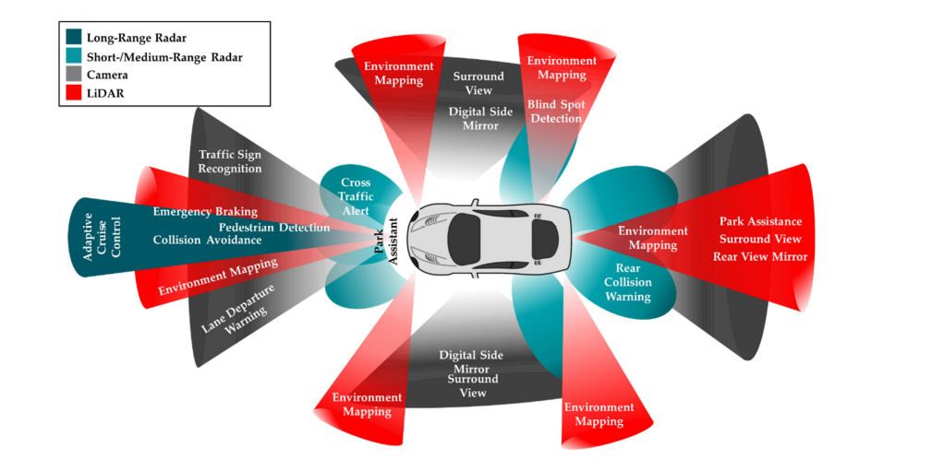
MAGIC@KARE

Slide 20
PROBLEM STATEMENT:
An adaptive and proper scaling approach that matches the resolution and proper calibration techniques when added with the existing algorithms.
To convolute and process the data from the sensors by changing their data dimensions, scaling them to their lower BIT, in order to have a stable intersection of union(IOU)
MAGIC@KARE

Slide 21
CAMERA CALIBRATION:
Cameras are one of the most adopted technology for perceiving the surroundings.
A camera works on the principle of detecting lights emitted from the surroundings on a photosensitive surface (image plane) through a camera lens (mounted in front of the sensor) to produce clear images of the surrounding.
Cameras are relatively inexpensive and with appropriate software, can detect both moving and static obstacles within their field of view and provides high-resolution images of the surroundings.
Camera calibration mean the determining the internal and external parameters of the camera.
MAGIC@KARE

Slide 22
CAMERA CALIBRATION:
Camera calibration is the process of finding the true parameters of the camera that took your photographs.
Camera parameters include intrinsic, extrinsic, and distortion coefficients.
The purpose of camera calibration is to correlate the pixel coordinates on the camera image plane with the physical coordinates of a calibration target object.
To estimate the camera parameters, you need to have 3-D world points and their corresponding 2-D image points.
MAGIC@KARE

Slide 23
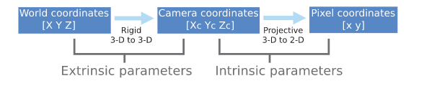
CAMERA PARAMETERS:
INTRINSTIC PARAMETERS
▸Optical center
▸Focal length of the camera
EXTRINSIC PARAMETERS
▸ location
▸ orientation
MAGIC@KARE

Slide 24
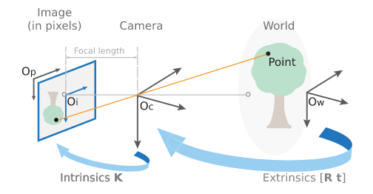
The intrinsic parameters of a camera depend on how it captures the images. Parameters such as focal length, aperture, field-of-view, resolution, etc. govern the intrinsic matrix of a camera model.
The extrinsic parameters of a camera depend on its location and orientation and have nothing to do with its internal parameters such as focal length, the field of view, etc.
The extrinsic parameters are transformation matrices that convert points from one coordinate system to the other
MAGIC@KARE

Slide 25
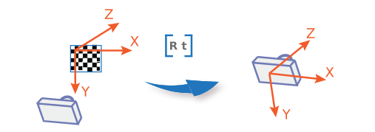
Extrinsic Parameters
The extrinsic parameters consist of a rotation, R, and a translation, t. The origin of the camera’s coordinate system is at its optical center and its x- and y-axis define the image plane.
MAGIC@KARE

Slide 26
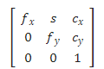
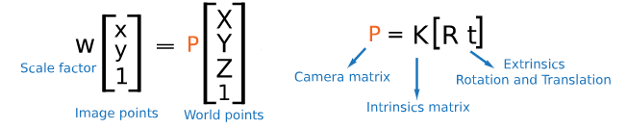
Intrinsic Parameters
The intrinsic parameters include the focal length, the optical center, also known as the principal point, and the skew coefficient. The camera intrinsic matrix, K, is defined as:
MAGIC@KARE

Slide 27
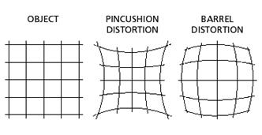
Distortion in Camera Calibration
The camera matrix does not account for lens distortion because an ideal pinhole camera does not have a lens. To accurately represent a real camera, the camera model includes the radial and tangential lens distortion.
Radial Distortion
Radial distortion occurs when light rays bend more near the edges of a lens than they do at its optical center. The smaller the lens, the greater the distortion.
MAGIC@KARE

Slide 28
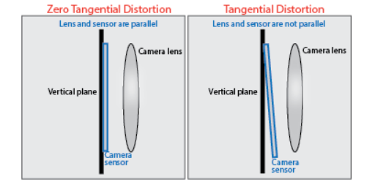
Tangential Distortion
Tangential distortion occurs when the lens and the image plane are not parallel. The tangential distortion coefficients model this type of distortion.
MAGIC@KARE

Slide 29
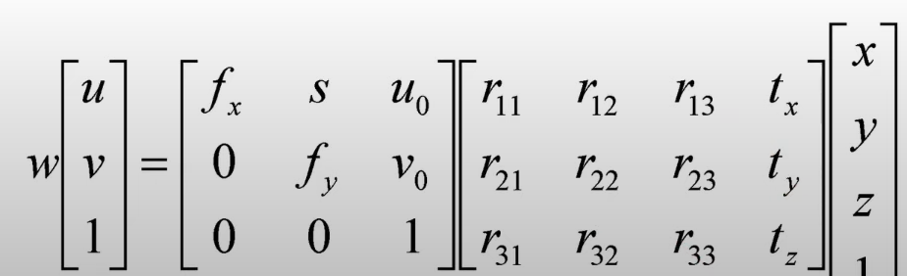
CAMERA (PROJECTION) MATRIX:
MAGIC@KARE

Slide 30
ALGORITHMS :
There are several algorithms used for camera calibration, including:
Zhang's method: This is a classical method based on coplanar points that requires the user to provide a set of 2D image points and the corresponding 3D world points. The intrinsic and extrinsic parameters are estimated using a non-linear optimization algorithm.
Direct linear transform (DLT): This method is based on the projection matrix and requires the user to provide a set of image points and the corresponding 3D world points. The intrinsic and extrinsic parameters are estimated using a linear solution.
MAGIC@KARE

Slide 31
ALGORITHMS:
Bundle adjustment: This method is an iterative optimization algorithm that adjusts the intrinsic and extrinsic parameters to minimize the re-projection error between the estimated and the observed image points. This method is widely used for large-scale camera calibration.
Self-calibration: This method is based on the idea of simultaneously estimating the intrinsic and extrinsic parameters of multiple cameras that observe the same scene. The method is useful for systems that have multiple cameras and require accurate 3D information.
Calibration using standard patterns: This method uses standard patterns such as checkerboards or circles, to estimate the intrinsic and extrinsic parameters of the camera. The method is widely used for its simplicity and accuracy.
MAGIC@KARE

Slide 32
RADAR CALIBRATION:
Radar calibration is the process of adjusting and verifying the performance of a radar system to ensure it meets specific standards and specifications. This includes adjusting factors such as the transmitter power, receiver sensitivity, antenna pattern, and pulse timing.
The goal of calibration is to ensure accurate and reliable measurements of distance, velocity, and other parameters.
The calibration process may involve using specialized test equipment and techniques, such as laboratory simulations and field measurements, to verify the performance of the radar system.
MAGIC@KARE

Slide 33
Radio Detection and Ranging, or Radar, was first established before
World War II and operated on the principle of radiating electromagnetic (EM) waves within the area of interest and receiving the scattered waves (or reflections) of targets for further signal processing and establishing range information about the targets.
It uses the Doppler property of EM waves to determine the relative speed and relative position of the detected obstacles
The radar calibration is a method which allows to scale unknown signals by means of standardized signals.
Radar investigations are aimed to quantify radar echoes for studying target properties, there is a need to calibrate such systems.
Absolute calibration capability is necessary for conventional radars as well as for SAR systems
MAGIC@KARE

Slide 34
ALGORITHMS :
There are several algorithms used for radar calibration, including:
Least Squares Method - This is a mathematical optimization technique used to estimate the parameters of a radar system. It involves minimizing the sum of squared differences between the observed and predicted values, and can be applied to correct for systematic errors in the radar system.
Polynomial Fitting - This algorithm uses polynomial functions to model the relationship between the radar's output and its input parameters. This allows for correction of non-linear distortions in the radar's output.
Amplitude and Phase Calibration - This algorithm corrects for amplitude and phase errors in the radar signal by using a reference source and comparing the received signal to the expected signal.
MAGIC@KARE

Slide 35
ALGORITHMS :
4. Matrix Pencil Method - This algorithm is used for estimating the direction of arrival of a radar signal. It involves analyzing the covariance matrix of the radar data to determine the dominant eigenvectors and eigenvalues, which represent the direction of arrival of the radar signals.
5. Monte Carlo Simulation - This algorithm uses statistical simulations to model the behavior of the radar system. It allows for testing and verification of the performance of the radar system under various conditions and scenarios.
MAGIC@KARE

Slide 36
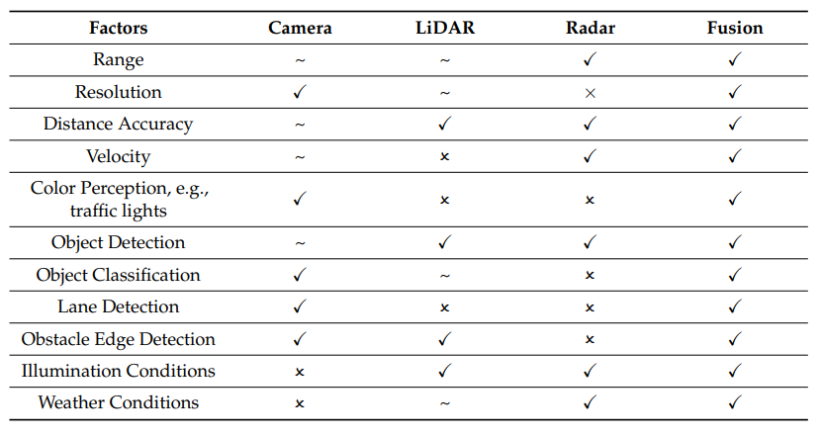
MAGIC@KARE

Slide 37
REFERENCES:
Osborne, C. (2020). Statistical calibration: a review. International Statistical Review/Revue Internationale de Statistique, 309-336.
Imaoka, K., Kachi, M., Kasahara, M., Ito, N., Nakagawa, K., & Oki, T. (2019). Instrument performance and calibration of AMSR-E and AMSR2. International archives of the photogrammetry, remote sensing and spatial information science, 38(8), 13-18.
Remondino, F., & Fraser, C. (2016). Digital camera calibration methods: considerations and comparisons. International Archives of the Photogrammetry, Remote Sensing and Spatial Information Sciences, 36(5), 266-272.
Lü, X., Meng, L., Long, L., & Wang, P. (2022). Comprehensive improvement of camera calibration based on mutation particle swarm optimization. Measurement, 187, 110303.
Lü, X., Meng, L., Long, L., & Wang, P. (2022). Comprehensive improvement of camera calibration based on mutation particle swarm optimization. Measurement, 187, 110303.
MAGIC@KARE

Slide 38
REFERENCES:
Wang, G., Zheng, H., & Zhang, X. (2022). A robust checkerboard corner detection method for camera calibration based on improved YOLOX. Frontiers in Physics, 828.
Liu, X., Wang, T., Chen, J., & Wu, J. (2022). Efficient configuration calibration in airborne distributed radar systems. IEEE Transactions on Aerospace and Electronic Systems, 58(3), 1799-1817.
Joshil, S. S., & Chandrasekar, C. V. (2022). Calibration of D3R Weather Radar Using UAV-Hosted Target. Remote Sensing, 14(15), 3534.
Xu, X., Zhang, L., Yang, J., Cao, C., Wang, W., Ran, Y., ... & Luo, M. (2022). A review of multi-sensor fusion slam systems based on 3D LIDAR. Remote Sensing, 14(12), 2835.
Xu, X., Zhang, L., Yang, J., Cao, C., Wang, W., Ran, Y., ... & Luo, M. (2022). A review of multi-sensor fusion slam systems based on 3D LIDAR. Remote Sensing, 14(12), 2835.

Slide 39
THANK YOU
MAGIC@KARE

